Slide 1
What use is a house
Keeps you safe
Keeps you comfortable

Slide 2
Safe?
Keep invaders and thieves and predators and harmful things out,
i.e. stop wind and rain getting to you…
Keep bugs and allergens away.
Make sure air quality is good.

Slide 3
When do we become uncomfortable?
If we lose heat rapidly (holding a cold lump of metal on uncovered bit of skin).
If we have a 2ºC difference across our body.
If we get sweaty.

Slide 4
Our houses are old, in those times we spent most of our time in reduced room numbers!
In 1970 average temperatures were 12º C
By 2010 it had reached 16.9º C
This was done simply by installing central heating. Not by improving insulation.
Not using fireplaces changes the ventilation!
Using cement instead of lime stops building breathability.

Slide 5
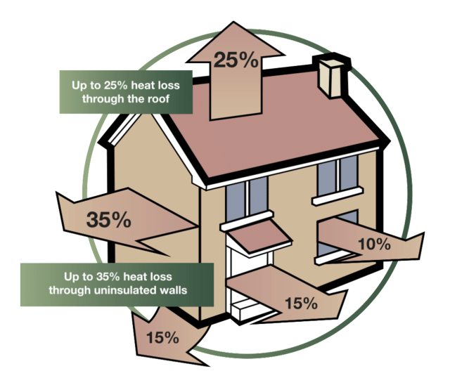

Slide 6
Each building is different
The heat loss calculation has the thermal conductivity of the building structure and the external area of this bit of the structure.
Usually a guess at the air leakage is factored in.
An estimate of the temperature differential is applied to calculate the heat loss for each bit of the structure..
The heating system is designed to be big enough able to balance the heat losses on a room by room basis.

Slide 7
Where do we start?
We Need A PLAN!

Slide 8
What does the householder desire?
Reduction in Energy use
Reduction in Energy Cost
Reduction of emissions
Comfort Improvement (where is the house least comfortable?)
improve air quality
reduce overheating
Get rid of condensation,damp,mould?
improve house’s energy rating
Meet a performance standard
Improve buildings usefulness
Protect the building from decay
Improve water/flood protection
Change the building structure (Extension etc)
Protect architectural heritage
Other

Slide 9
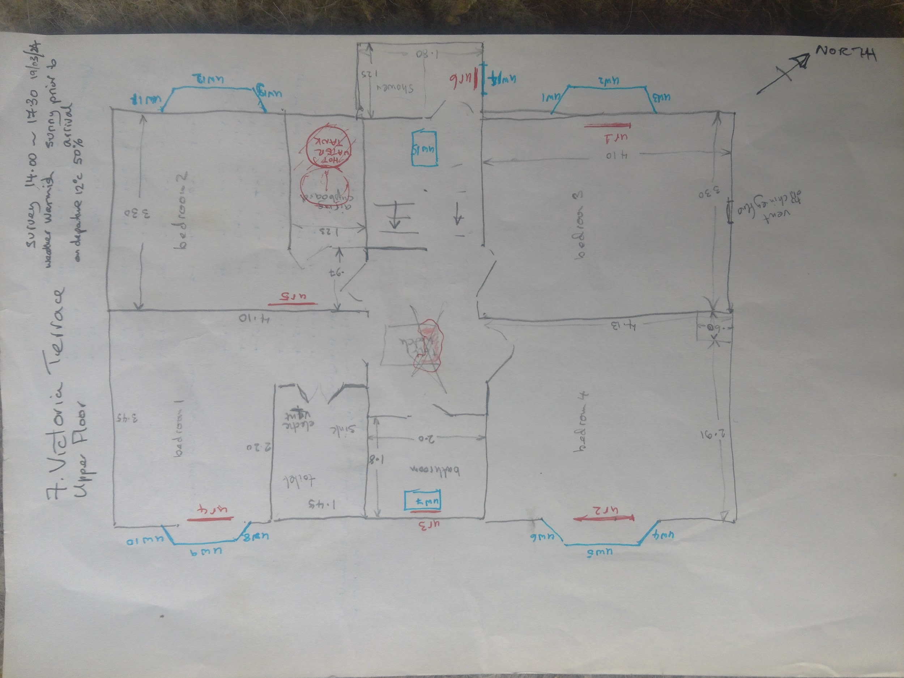

Slide 10
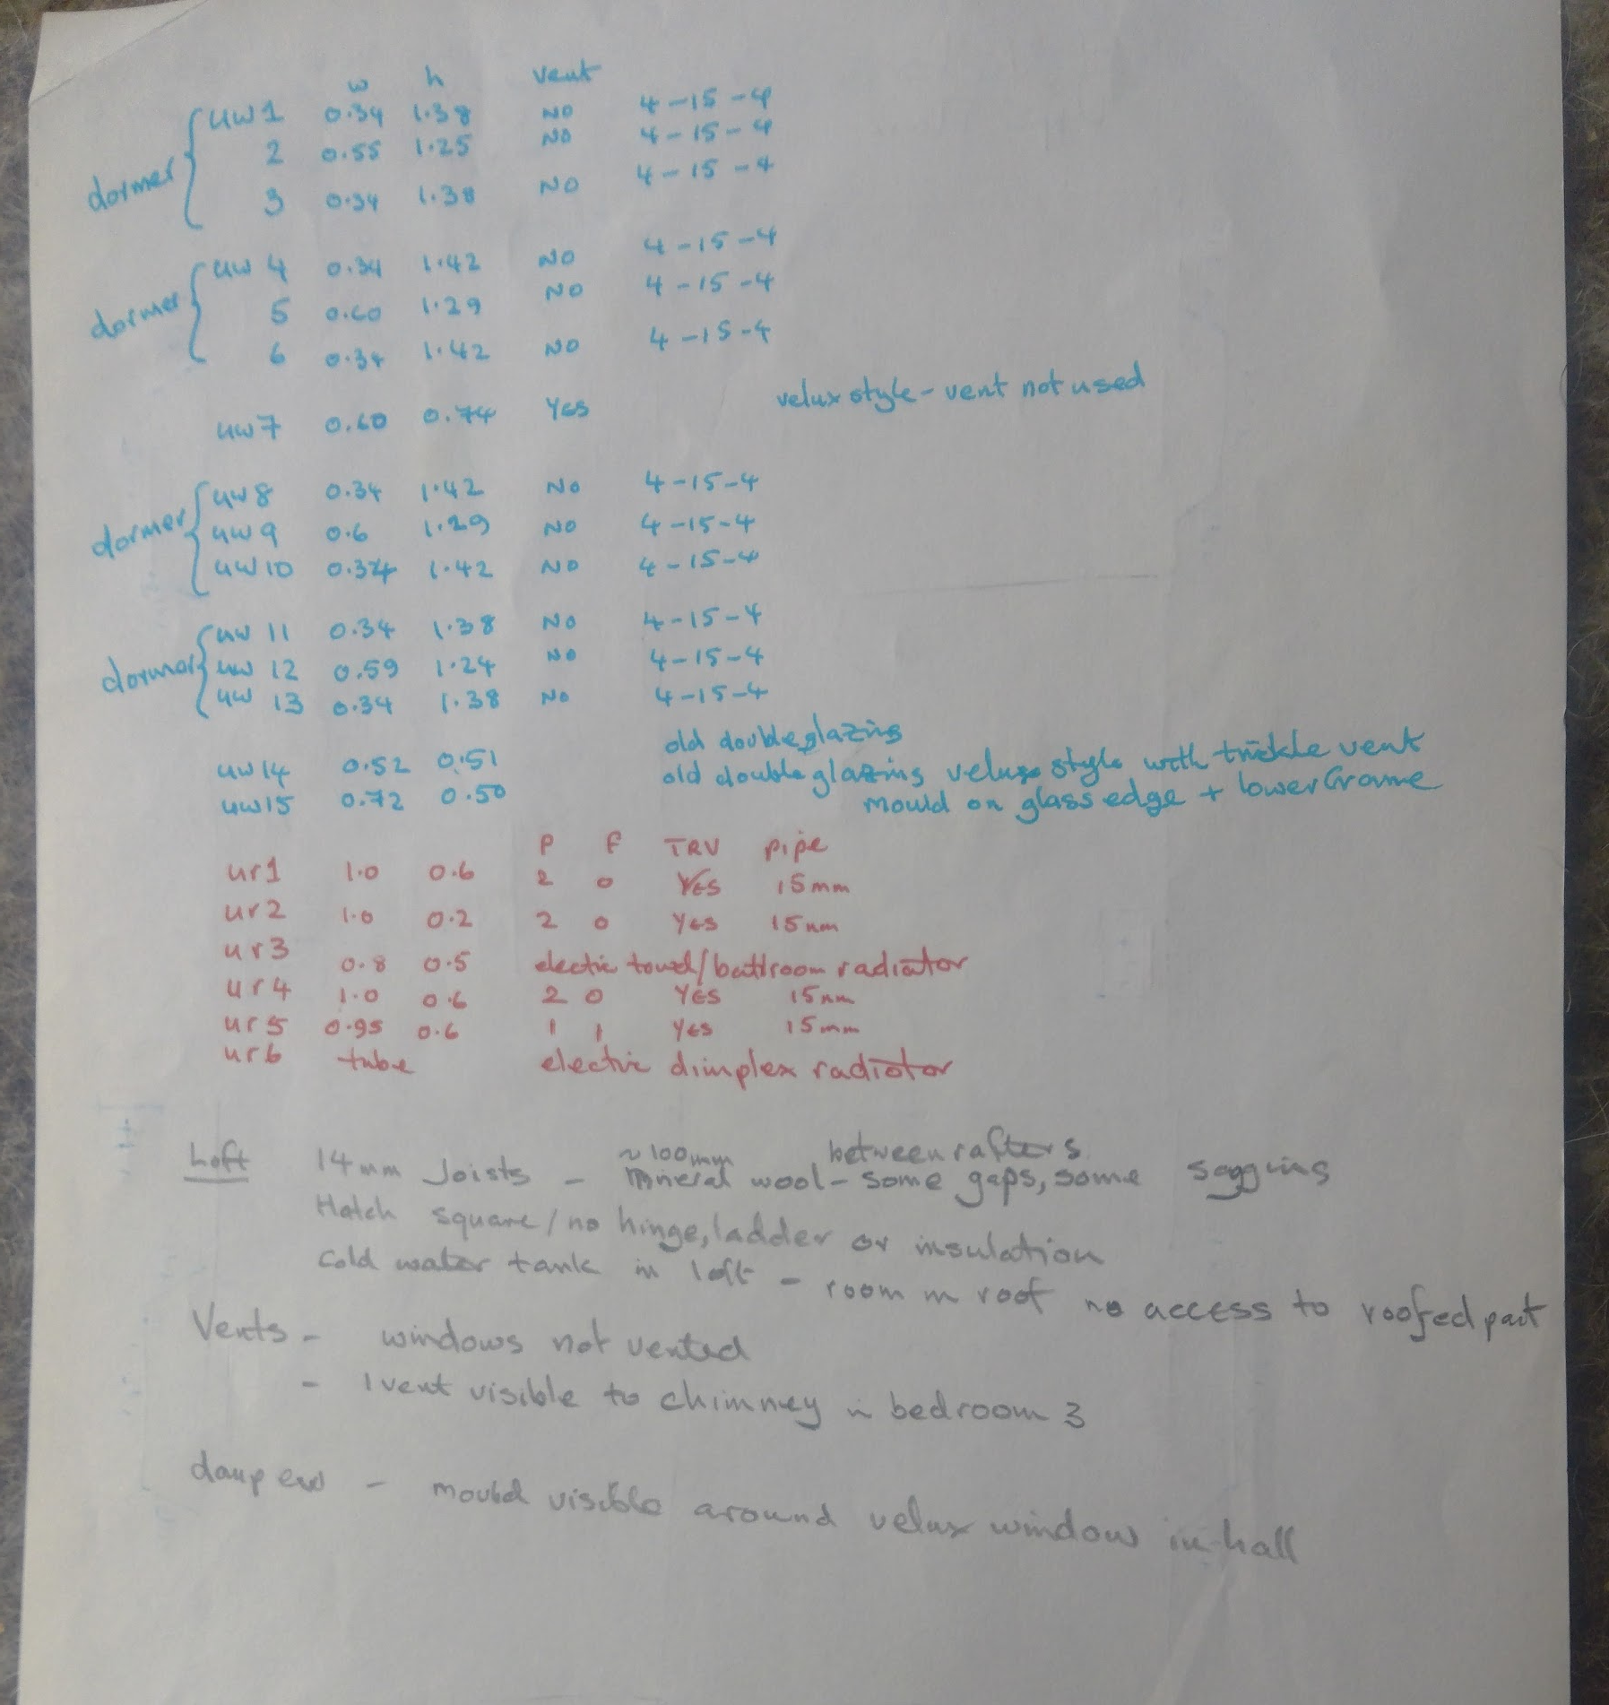

Slide 11
Thermal Imaging
To find hot and cold parts

Slide 12
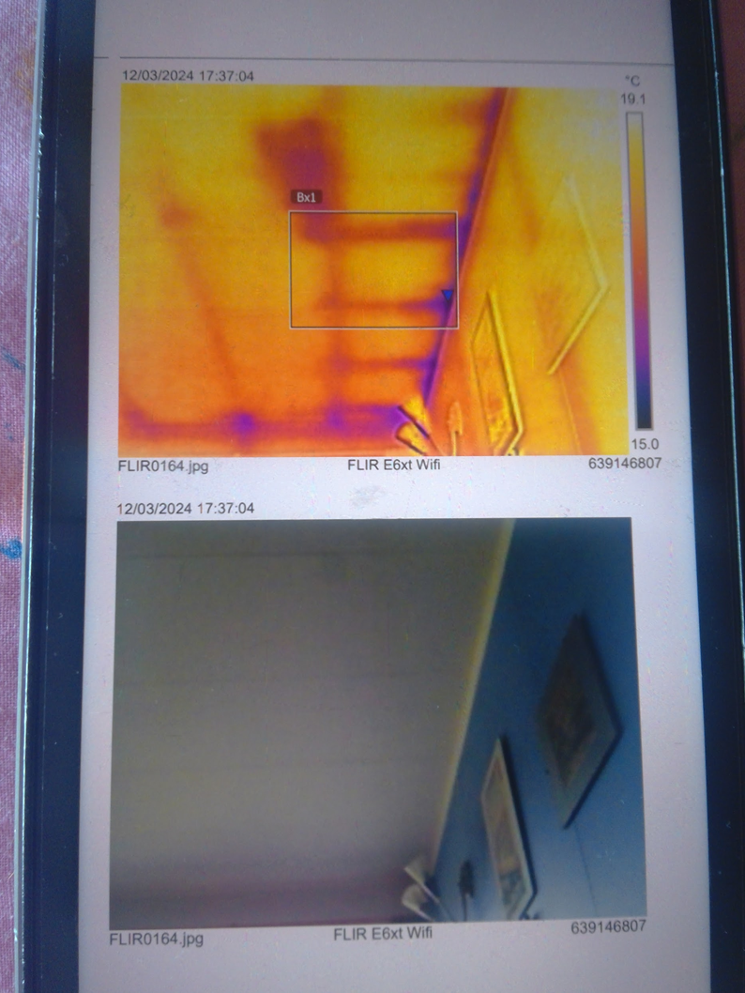

Slide 13
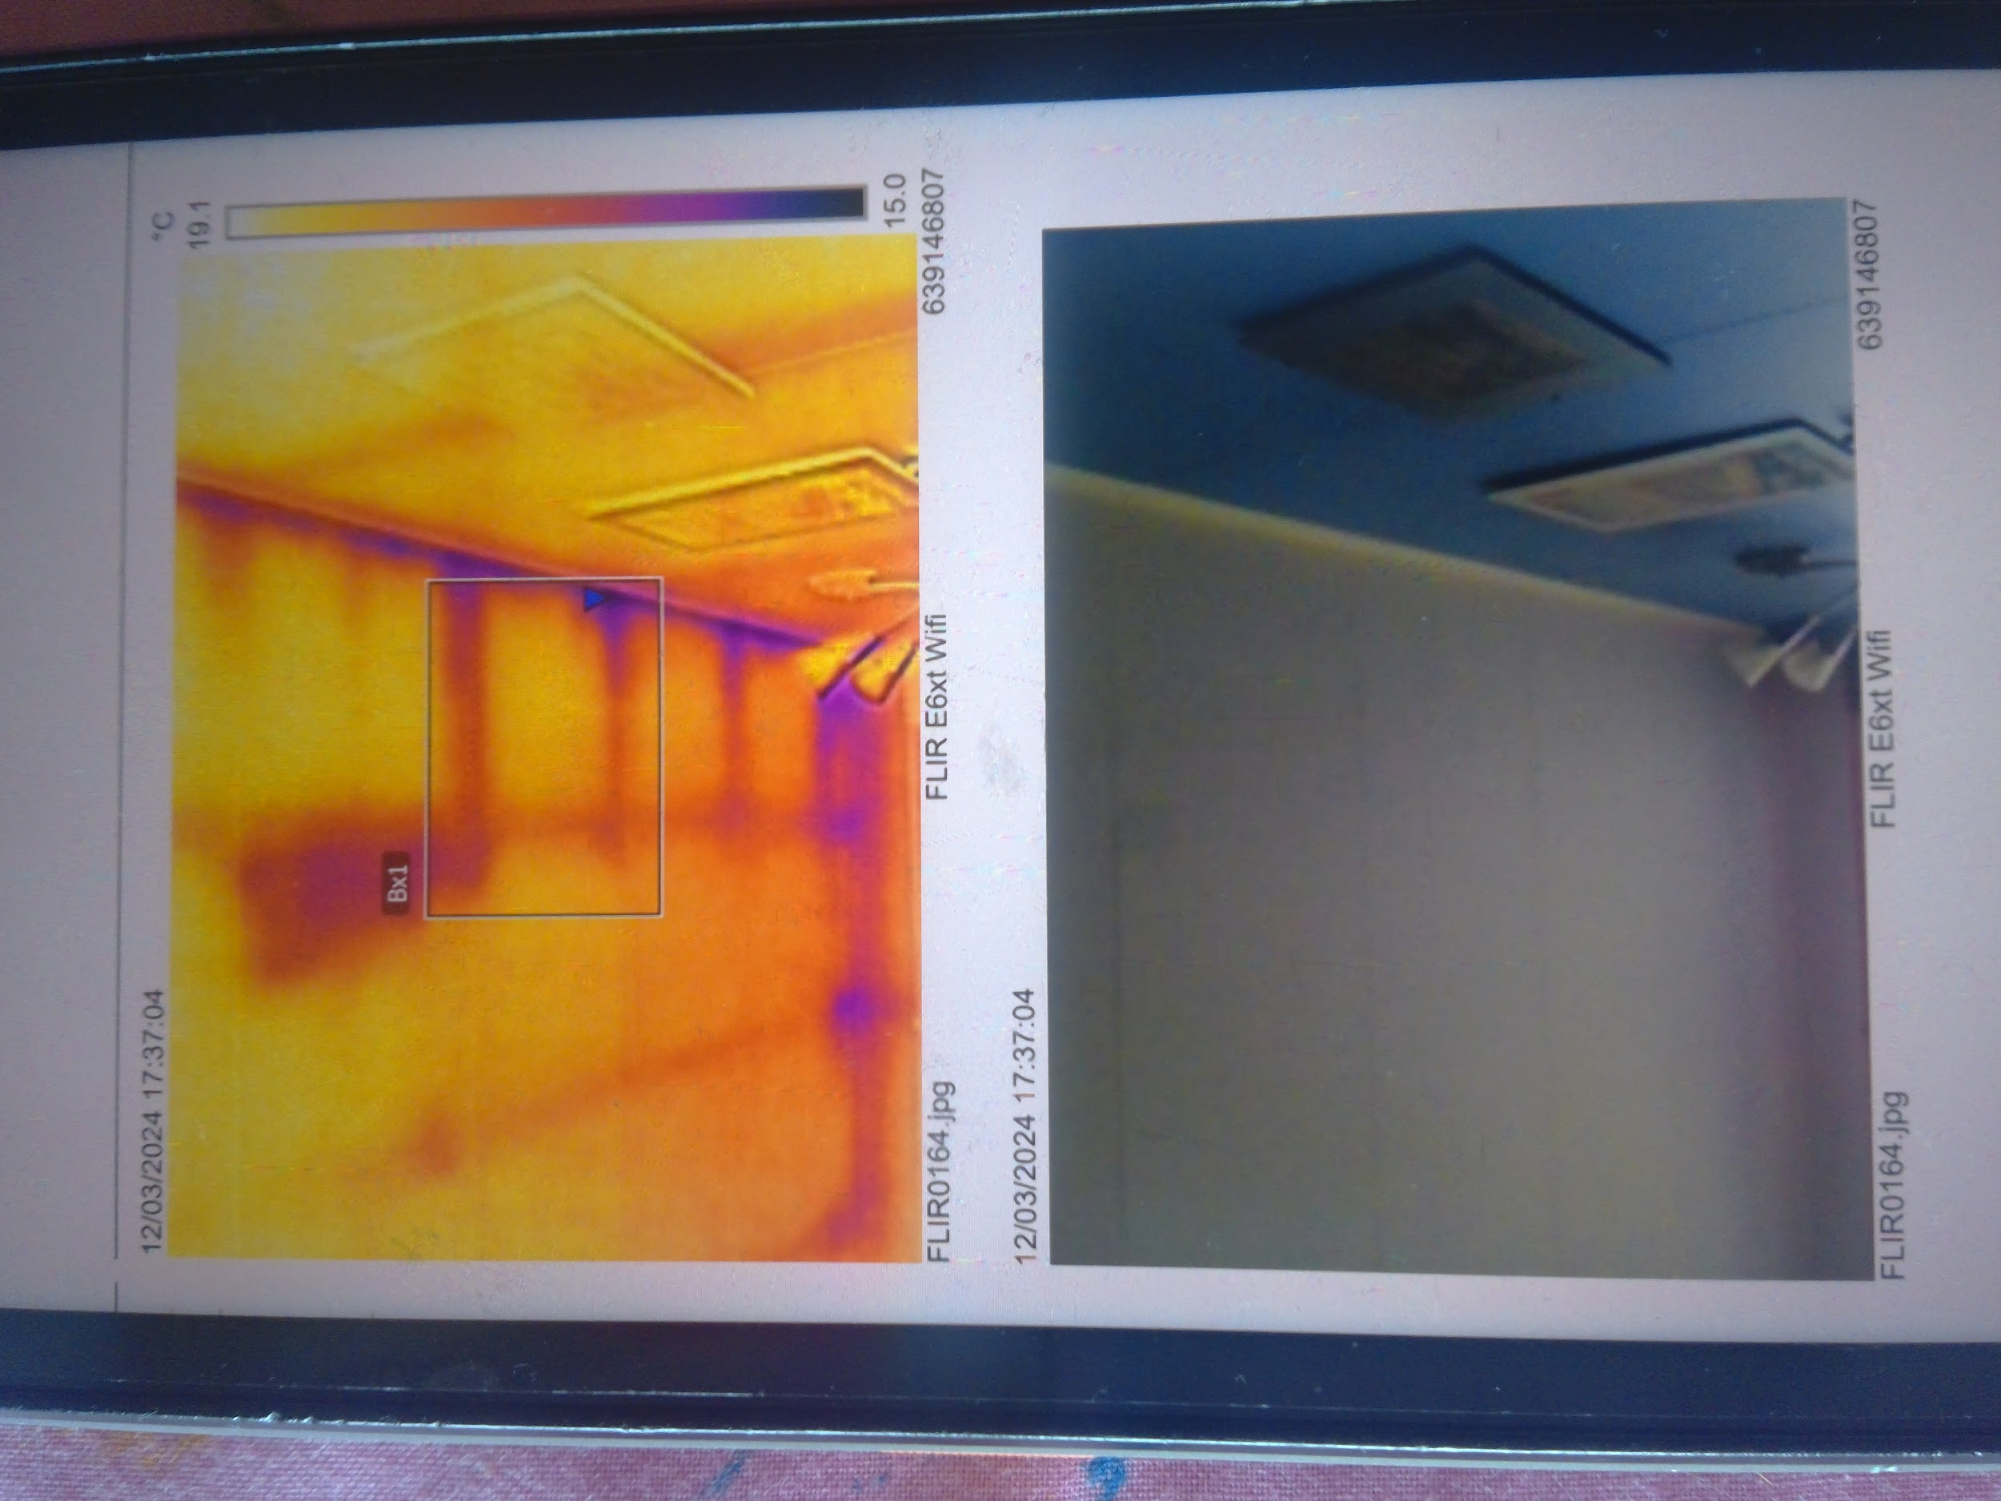

Slide 14
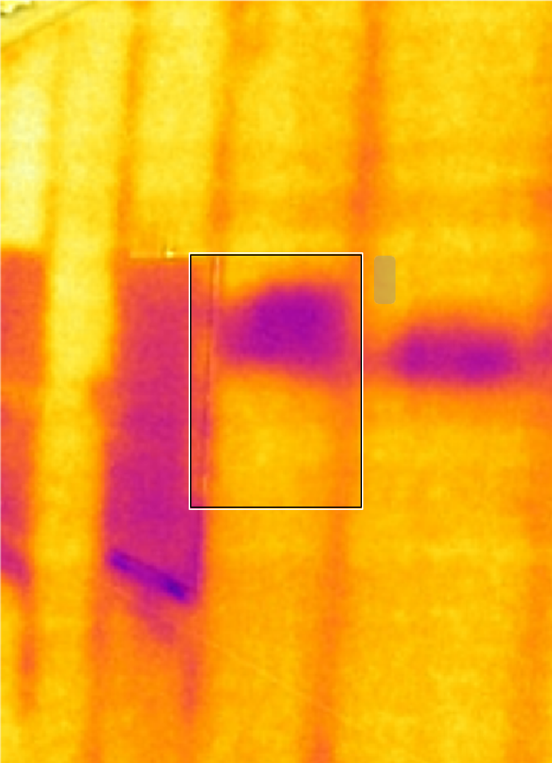

Slide 15
