Slide 1
Two storey semi-detached east west facing, no tree/building shading to east, next semi to south shades gable end.
100m2, one door in gable that has light showing on open edge.
Inner door, three rooms and recently fitting shower room downstairs, open living space, kitchen boiler cubby and toilet upstairs
Year old gas combi, a mix of pipe bores to the radiators. Householder only uses living space and hall radiator plus towel rail to keep the house at 19degrees with thermostat upstairs so 3 rooms downstairs are cooler. Radiators in every room with thermostatic valves. Time periods and coming home app installed.
Ventilation fans in kitchen and shower room, some windows have working trickle vents.
Windows, 6 panes of double glazing are blown, seals in poor condition, missing stays and the wooden frames have cosmetic damage and some have slivers of wood missing.

Slide 2
Usage
24 hours, mainly sedentary occupations.
Gas and electricity costs under £1700 per year, projected to be £1620 July 2023/24
Highest internal summer temperature 29 degrees
Householder priorities
New windows – cosmetic and practical. Would like triple glazed,
New door – practical as it doesn’t fit and swells in wet weather making it difficult to close, vestibule is cold and cools through the wall to one room and under stairs.
Increased ventilation in kitchen shower and toilet without losing any heat as these are all on the cold side of the house.
Carbon reduction through insulation and solar as heat pump would impinge on space outdoors and necessary exterior painting and maintenance access.

Slide 3
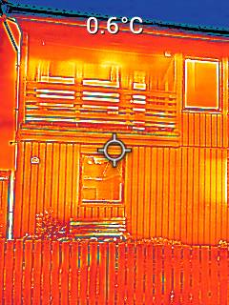
Thermostat set heating to 19 degrees during visit and outside temperature 4 degrees East face of wooden house. Painted brown with brown fence. The windows don’t appear much different from the walls but the overhanging roof to walls line is noticeably warmer

Slide 4
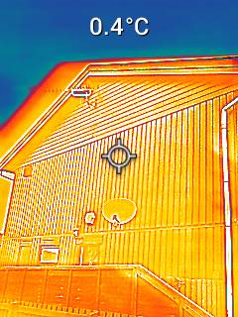
Gable end

Slide 5
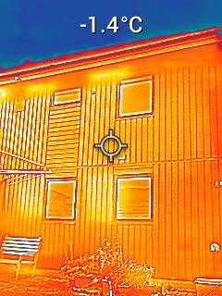
West facing - the cold side of the house

Slide 6
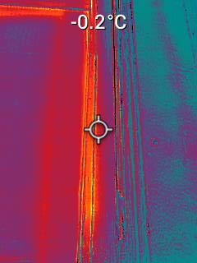
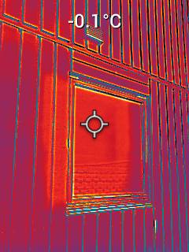
Wooden framed window on the west facing side.

Slide 7
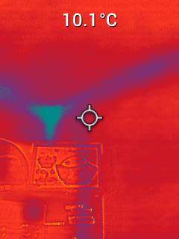
Ground Floor – top corner of room facing east

Slide 8
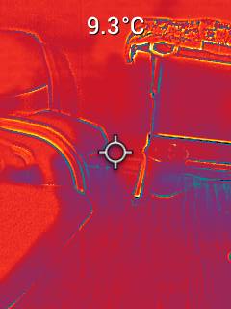
This shows a chair and table in the ground floor east facing room.

Slide 9
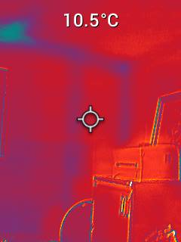
Ground floor south facing gable wall - shows the framing, with a colder spot than might be expected in the ceiling.

Slide 10
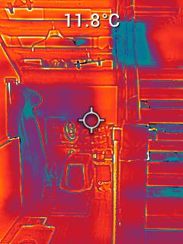
Under the open wood stairs. Radiator far left, waterproof jacket hanging on peg. The colder spot beside the jacket is above stack of water bottles and the upper cold spot is the landing window on the gable.

Slide 11
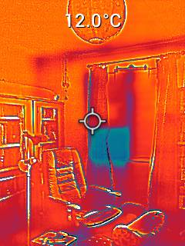
Ground floor west facing library – this is the only room with a carpet. There is privacy film over the top of the top 2/3 of the window to cut down sunlight. More bulk in this room, thermal mass?

Slide 12
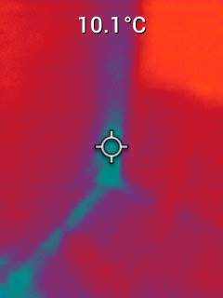
Ground floor library south west corner ceiling adjoining next door.

Slide 13
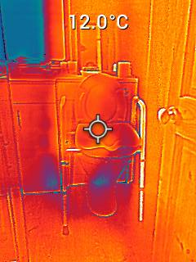
Ground floor west facing shower room. Cold window, with tap as the cut out, other colder spots unexplained.

Slide 14
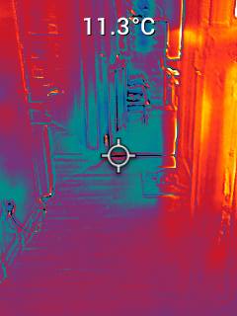
Not sure ? - Looks like a socket bottom left but no sockets in shower room so perhaps across hallway

Slide 15
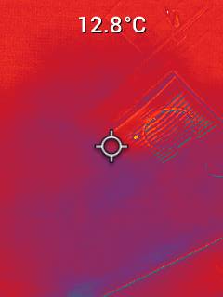
Ceiling vent shower room

Slide 16
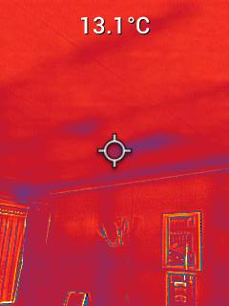
1st floor south facing gable corner. Ceiling joists and wall framing.

Slide 17
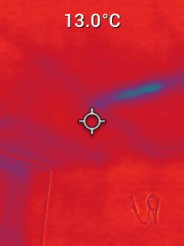
1st floor ceiling. Expect the loft insulation is not in the correct place plus the insulation does not cover the joists

Slide 18
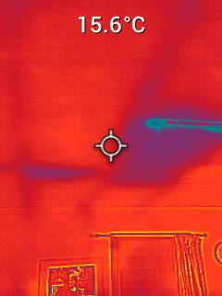
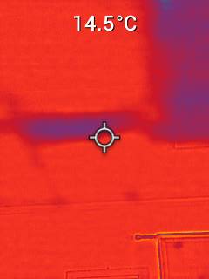
1st floor loft hatch, is the other line just insulation been moved ?

Slide 19
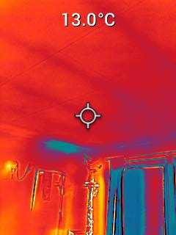
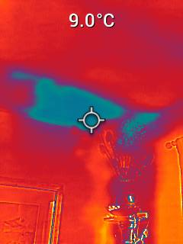
Ist floor east facing window with curtain and cold spot on party wall , ceiling joists and stand wrapped in fairy lights.

Slide 20
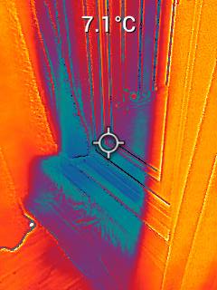
1st floor -? Perhaps living room window facing east

Slide 21
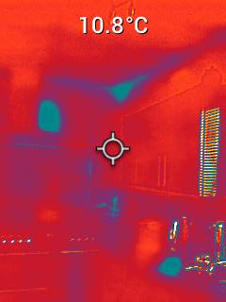
Kitchen facing south gable – cooker knobs, assume the cold rectangle is the cooker vent. Cold corner, window has a venetian blind

Slide 22
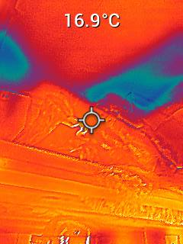
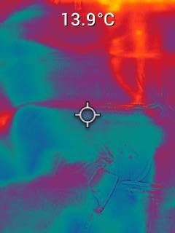
Even in the cubbyhole that contains the gas combi there is a temperature difference.

